Slide 1
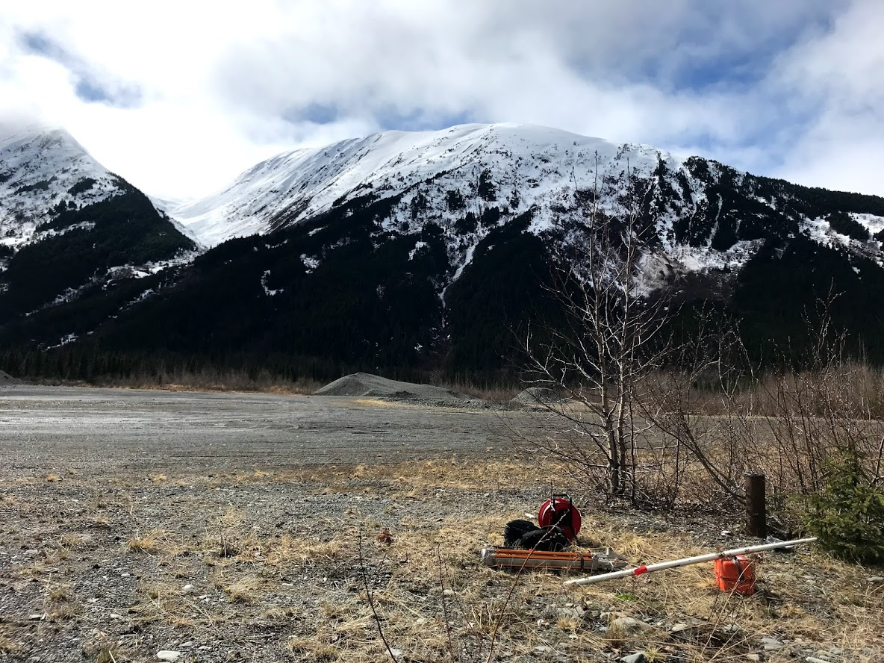
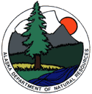
Alaska Groundwater Monitoring Program
Alaska Hydrologic Survey
Alaska Department of Natural Resources
Kevin Petrone and Jacob Coate (Anchorage)
Terry Schwarz (Juneau)
Jim Vohden (Fairbanks)
Workshop on Hydrogeology in Yukon, YT
February 19, 2020

Slide 2
Alaska Groundwater Monitoring Program
Why Are Groundwater Level Data Needed?
Water availability for Muni/Borough/Village Potable Supply
  groundwater storage and recharge dynamics
  the response of groundwater aquifers to climate variability and drought
Water availability for surface water bodies
  the interaction between groundwater and surface-water
Water availability in response to natural disturbances
  the effect of earthquakes on groundwater levels and water supply wells

Slide 3
History of Groundwater Monitoring in Alaska (statehood-present)
In 1950s – much interest in water resources in Alaska – 100 wells inventoried after the Good Friday Earthquake with continuous pre- and post-response in >30 wells*
1972 USGS maintained 80 observation wells and 1 spring in Alaska
2013 the state began an ad-hoc groundwater monitoring program
2019 USGS maintains four observation well in Alaska
2020 TOTAL*: with combined efforts among local, state, and federal agencies with cooperation from private landowners increased the # of observation wells in Alaska to ~15 (~10 state, 4 USGS)
*Waller 1966 USGS Paper 544-B “Effects of the March 1964 Alaska Earthquake On the Hydrology of the Anchorage Area“

Slide 5
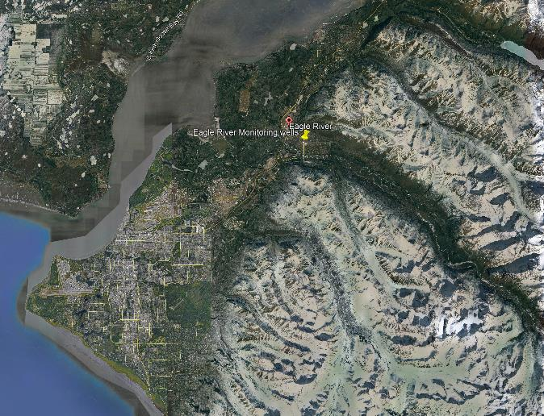
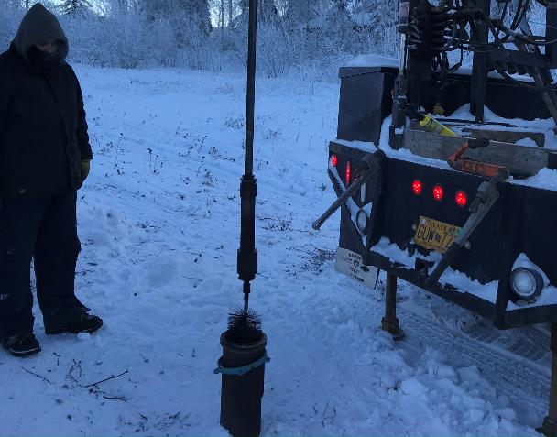
Monitoring Well Rehabilitation and Re-Establishment, Eagle River, AK
Well ER-5 confined, mid-valley aquifer
http://dggs.alaska.gov/webpubs/dggs/pr/text/pr108.pdf

Slide 6
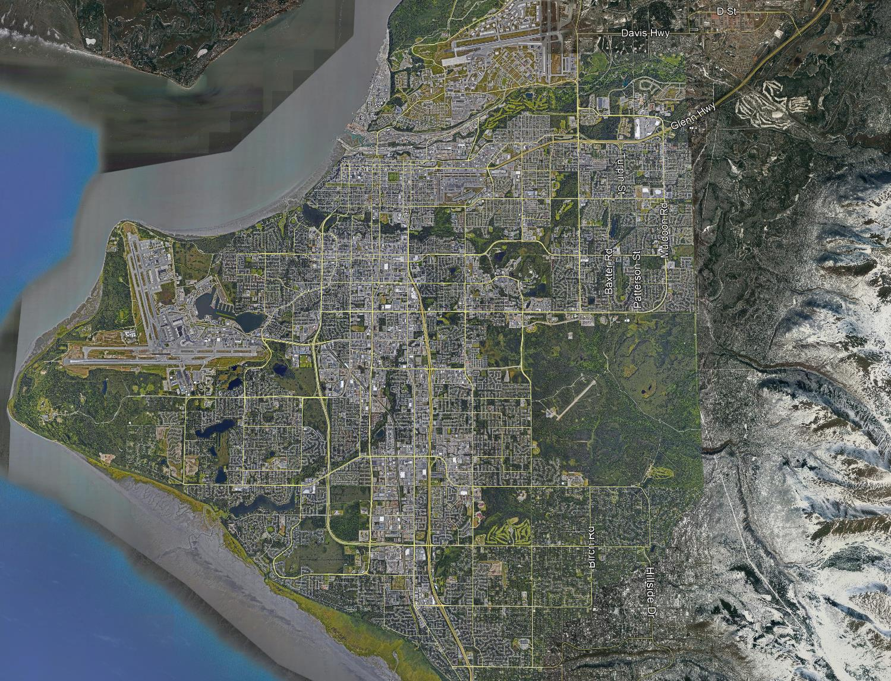
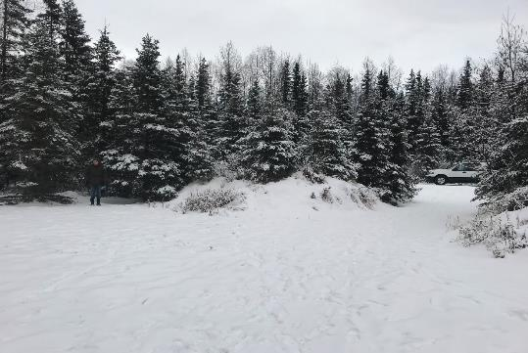
National Groundwater Monitoring Network
Drilling a new monitoring well before snow flies….this spring!

Slide 7
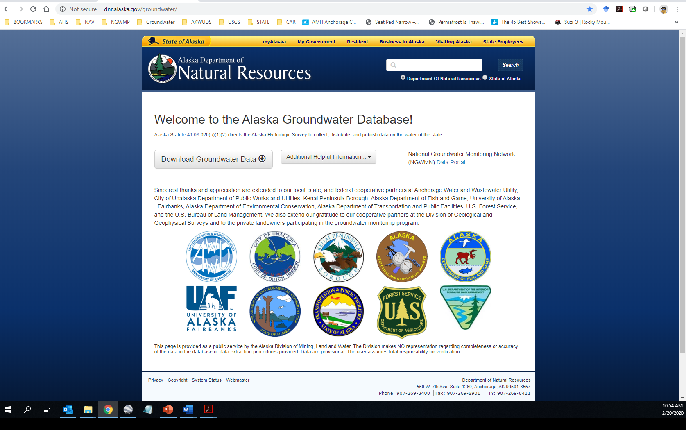
Alaska Groundwater Database
data harvested from AK state servers to the National Groundwater Monitoring Network

Slide 8
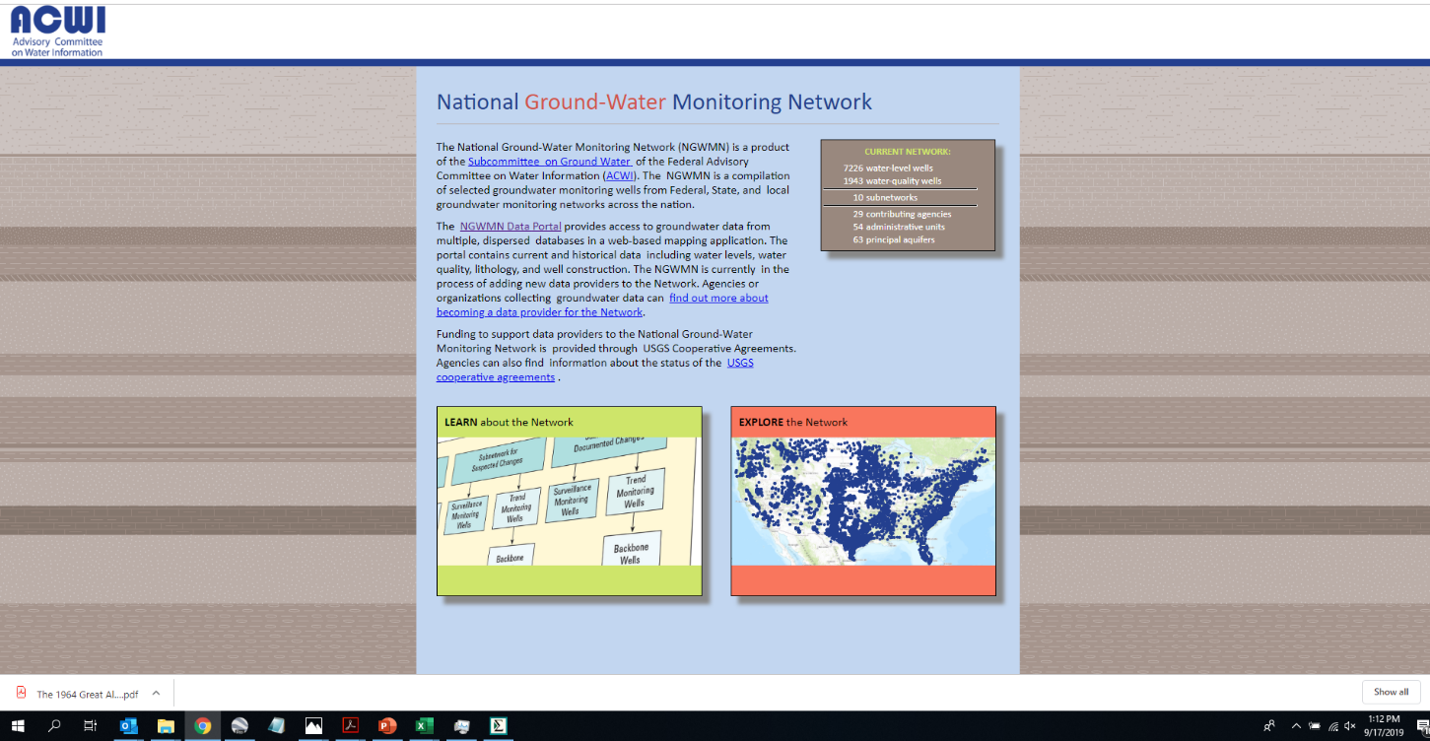
National Groundwater Monitoring Network
USGS Grant awarded to DNR in 2016
https://cida.usgs.gov/ngwmn/

Slide 9
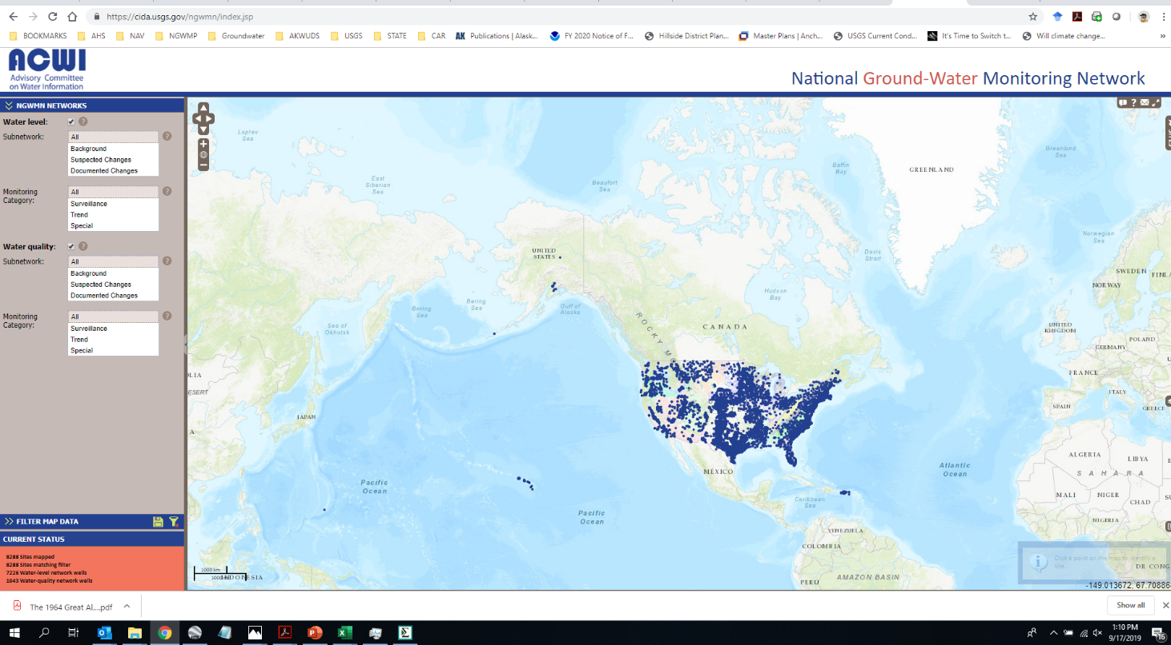
National Groundwater Monitoring Network
https://cida.usgs.gov/ngwmn/index.jsp

Slide 10
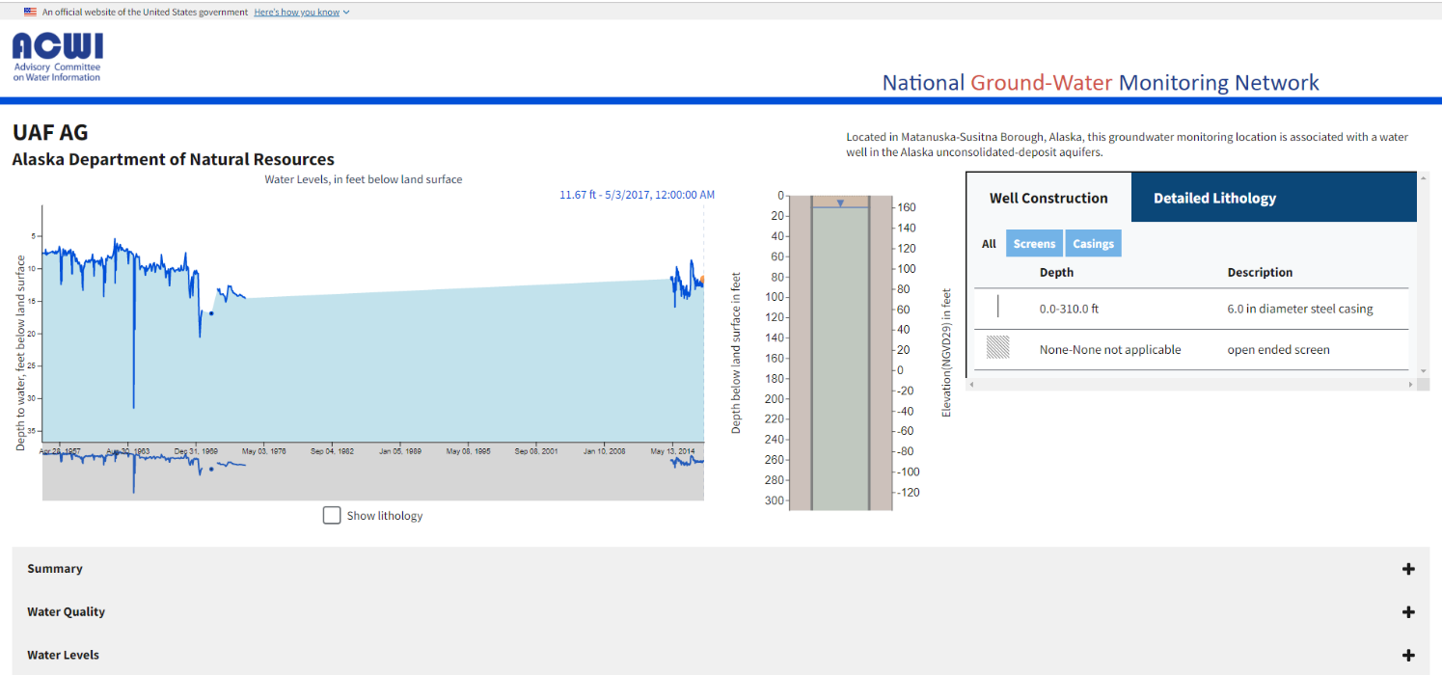
National Groundwater Monitoring Network
https://cida.usgs.gov/ngwmn/provider/AKDNR/site/613406149152103/

Slide 11
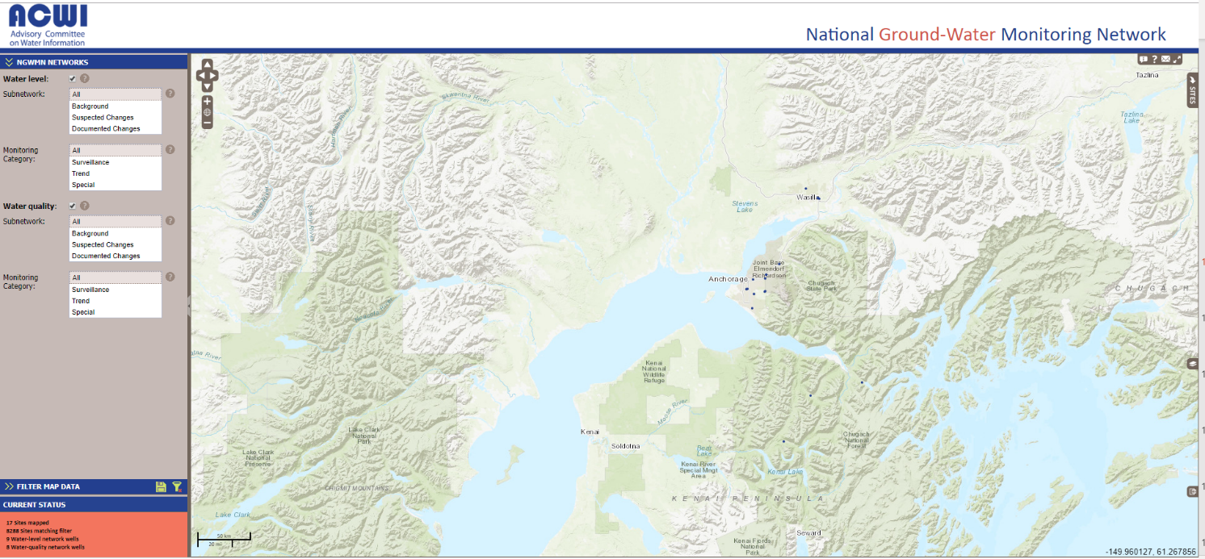
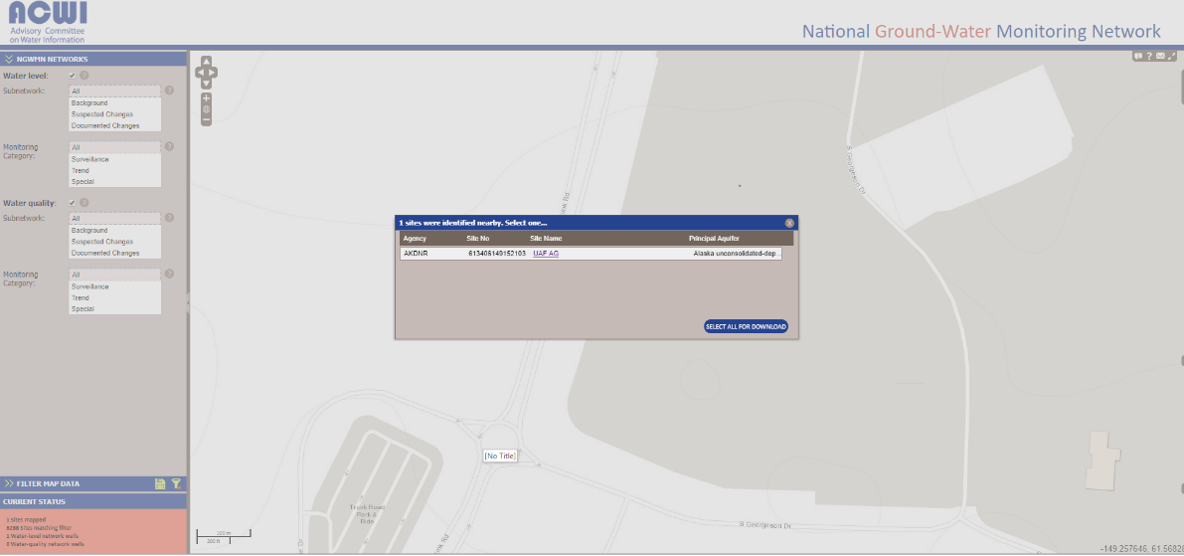
Matanuska Exp Farm Well – NGWMN

Slide 12
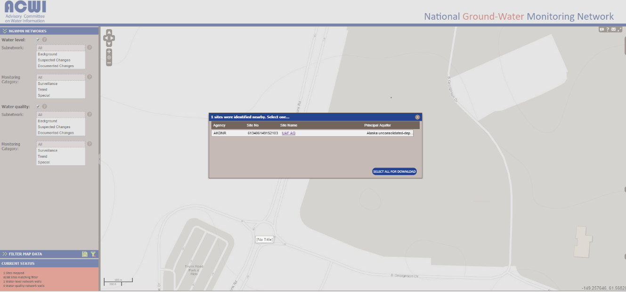
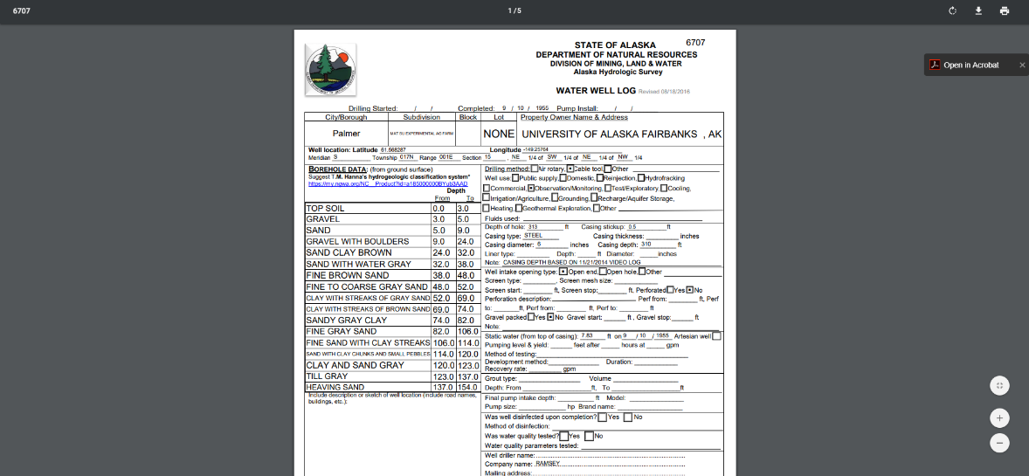
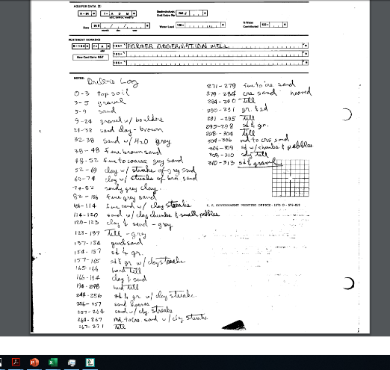
Matanuska Exp Farm Well – NGWMN
https://cida.usgs.gov/ngwmn/provider/AKDNR/site/613406149152103/

Slide 13
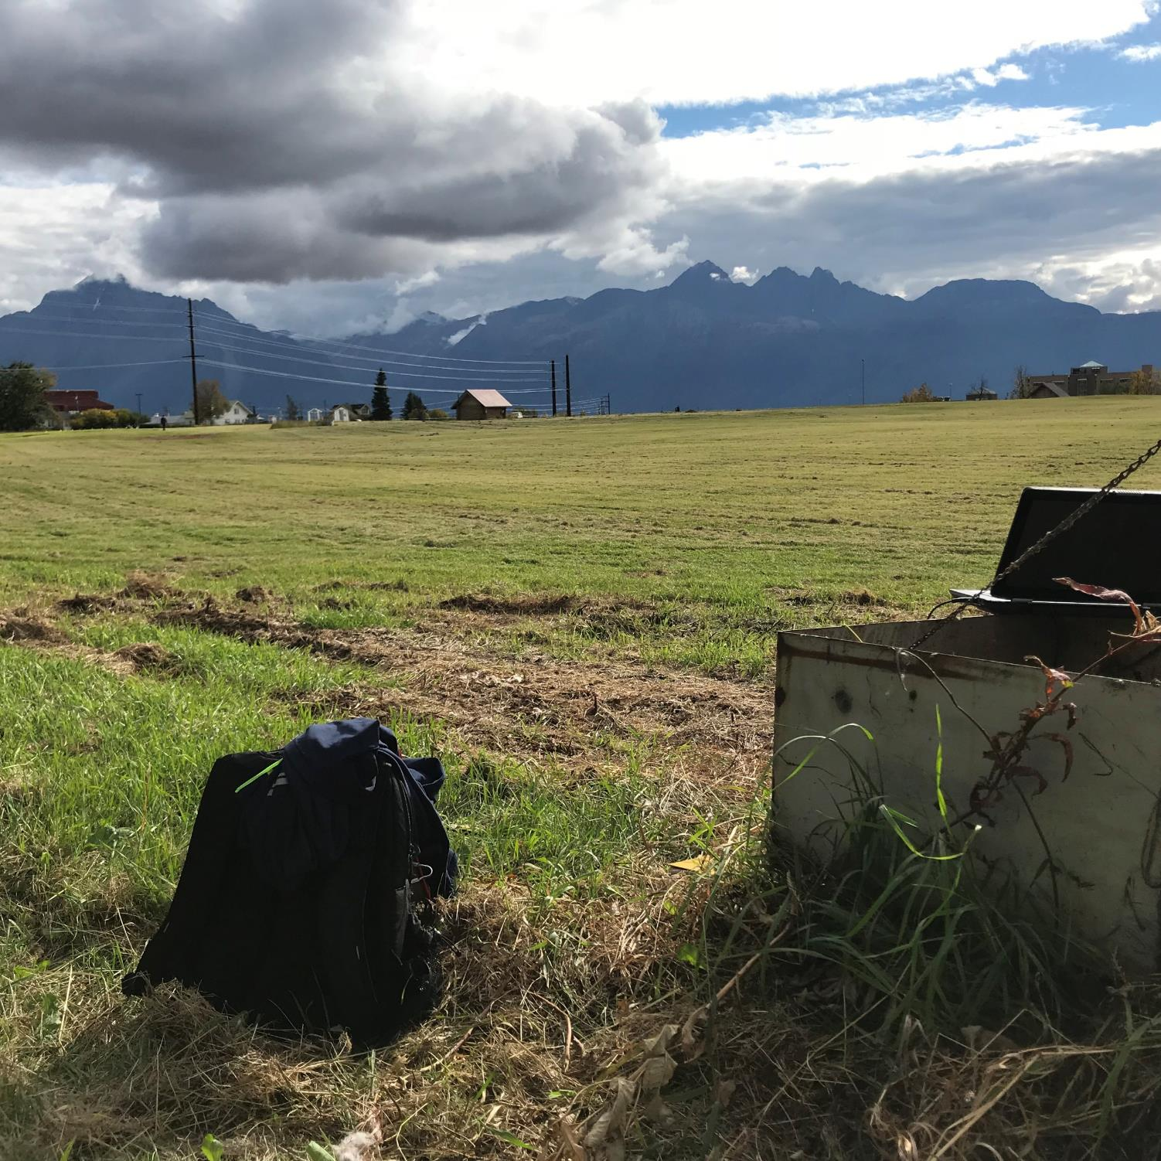
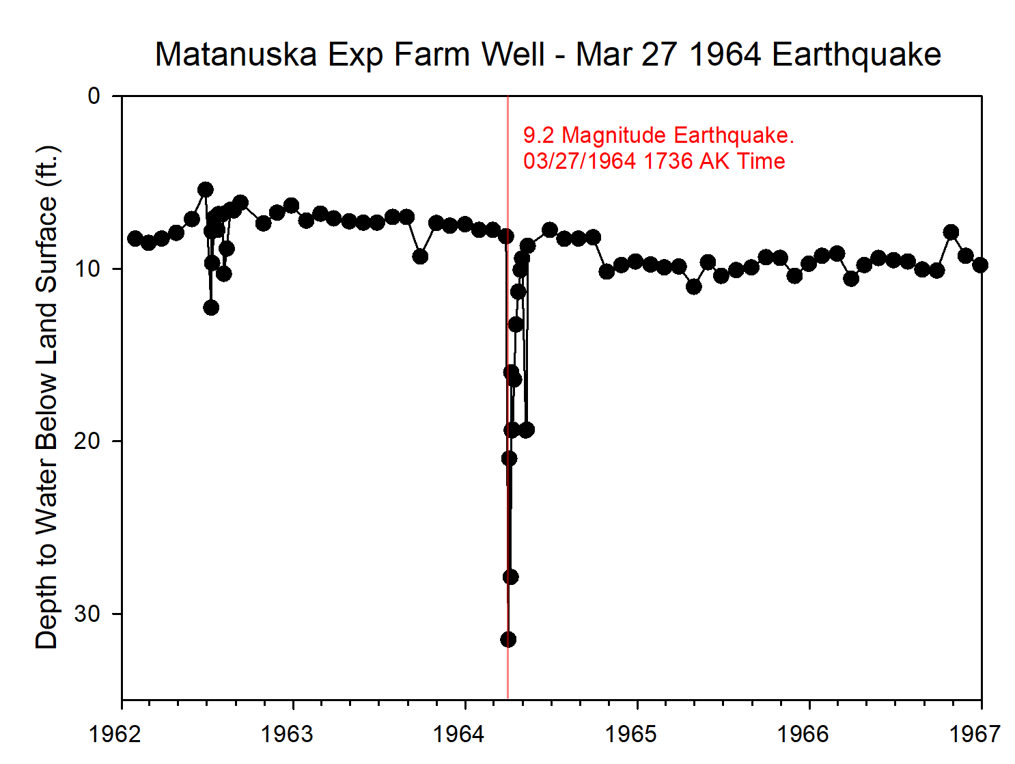
Matanuska Exp Farm Well – Earthquake Response

Slide 14
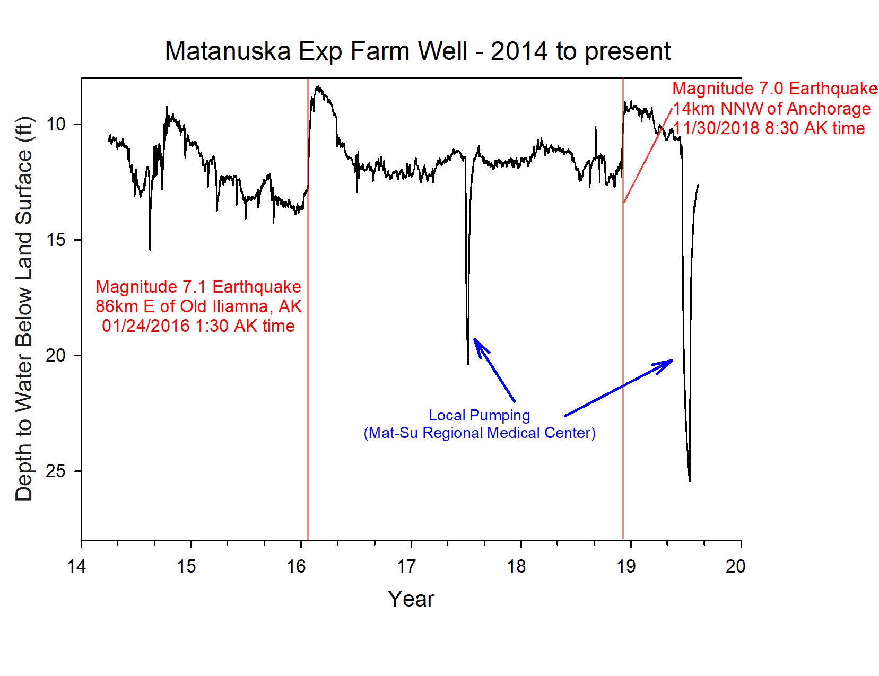
Matanuska Exp Farm Well – Earthquake Response

Slide 15
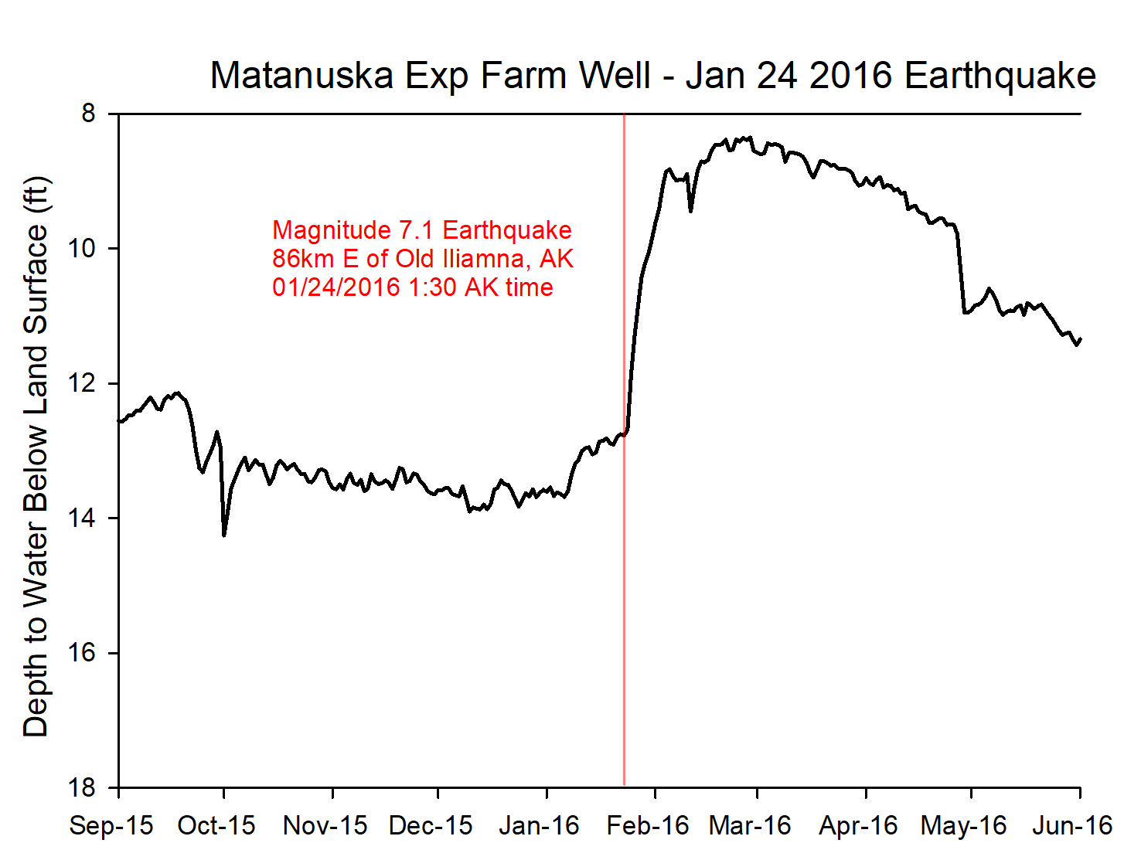
Matanuska Exp Farm Well – Earthquake Response

Slide 16
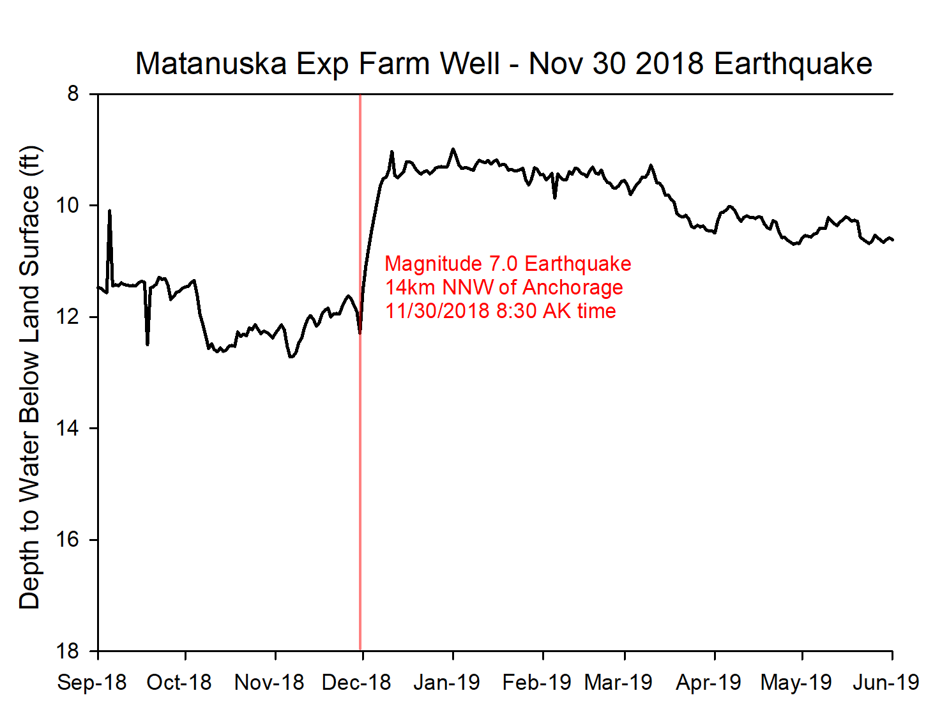
Matanuska Exp Farm Well – Earthquake Response

Slide 17
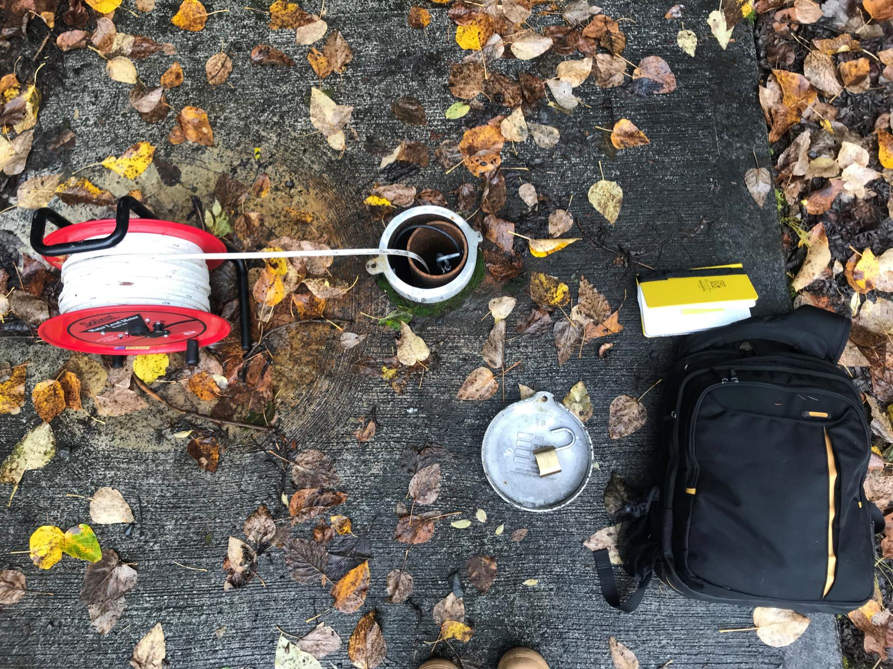
Questions
Contact information
Kevin Petrone phone: (907) 269-8646 email: kevin.petrone@alaska.gov

Slide 18
EFFECTS OF THE MARCH 1964 ALASKA EARTHQUAKE ON THE HYDROLOGY OF THE ANCHORAGE AREA, ALASKA
Generally, ground-water levels were residually lowered after the initial period of fluctuation. This lowering is attributed either to changes in the dis­charge zones offshore or to a change in the permeability of the aquifers by seismically induced strain.
Nearly all the pertinent data show that the artesian-pressure surface was lowered, locally as much as 24 feet, but that recovery started immediately and that within 6 months the water levels either had recovered to their former level or stabilized at a different level.

Slide 19
The Alaska Department of Natural Resources (ADNR) is a water-level data provider to the National Groundwater Monitoring Network (NGWMN; https://cida.usgs.gov/ngwmn/). Funding to support data providers to the National Ground-Water Monitoring Network is provided through USGS Cooperative Agreements. The ADNR collects groundwater data to evaluate changes in groundwater storage and recharge, the interaction between groundwater and surface-water, the response of groundwater systems to climate variability and drought, and the effects of earthquakes on groundwater levels. We will provide an update on current status of monitoring wells and highlights of results to date.

Slide 20
Alaska DNR and Statutory Responsibility
The Alaska Hydrologic Survey within the Department
of Natural Resources is mandated by Alaska Statute (AS) 41.08.017, AS 41.08.020 and Department Order 115 to collect, record, and require filing of data on the quantity, location and quality of water in the subsurface, surface, or along the coasts.
Unfunded mandates
State’s groundwater monitoring program is still in its infancy, only one water level station has 5 years
or more of data

Slide 21
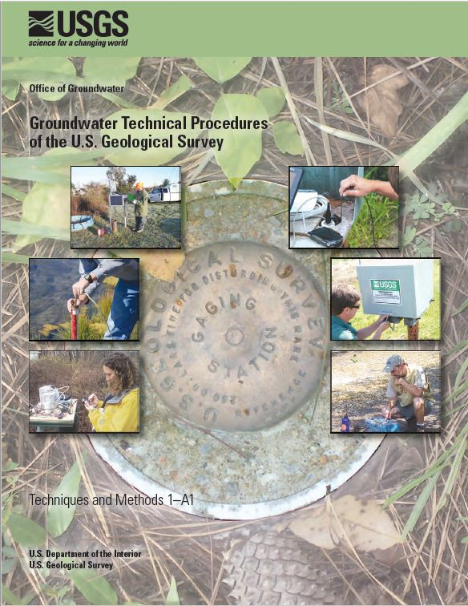
Methods & Procedures
http://pubs.usgs.gov/tm/1a1/

Slide 22
